Slide 1
Underwater Image Enhancement
Research Project
Shaon Kumer Paul
Roll No.: 120CS0673
under the supervision of
Pankaj Kumar Sa
&
Santos Kumar Panda
Department of Computer Science and Engineering NIT Rourkela-769008, India
October 17, 2023
Underwater Image Enhancement

Slide 2
Table of Contents
Introduction
Application Areas of Underwater Image Enhancement
Research Problems
Research Objectives
Research Question
Literature Review
Methodology
Proposed Approach
Image Pre-Processing Results
Expected Contributions
Timeline
Conclusion
References
Underwater Image Enhancement

Slide 3
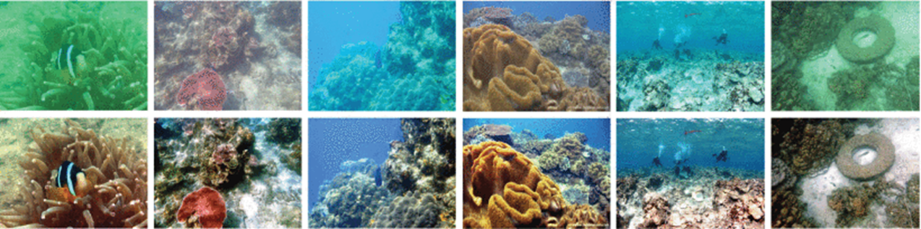
Introduction
Introduction
Underwater image enhancement is a set of techniques and processes to improve the quality and visibility of underwater images. Water naturally scatters and absorbs light, causing underwater photos to suffer from reduced contrast, color distortion, and blurriness. Underwater image enhancement aims to elevate the quality and visibility of images captured in aquatic settings.
Underwater Image Enhancement

Slide 4
Application Areas of Underwater Image Enhancement
Application Areas of Underwater Image Enhancement
Application Areas of Underwater Image Enhancement
Underwater Image Enhancement

Slide 5
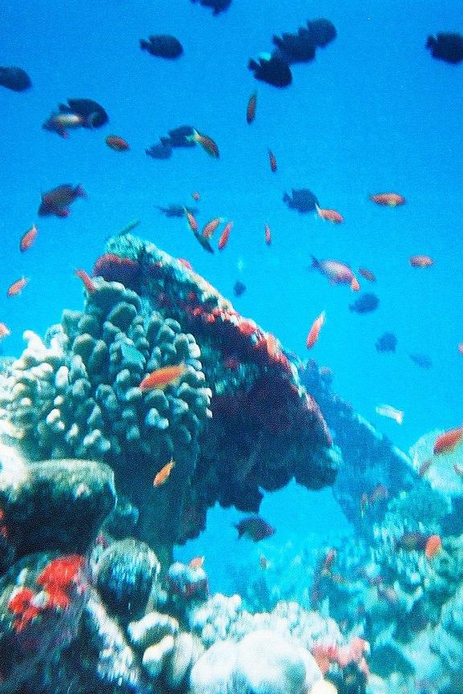
Application Areas of Underwater Image Enhancement
Marine Biology and Ecology
Underwater image enhancement is crucial for marine biologists and ecologists. Because Enhanced images provide clearer details about various species, behaviors, and interactions.
Underwater Image Enhancement

Slide 6
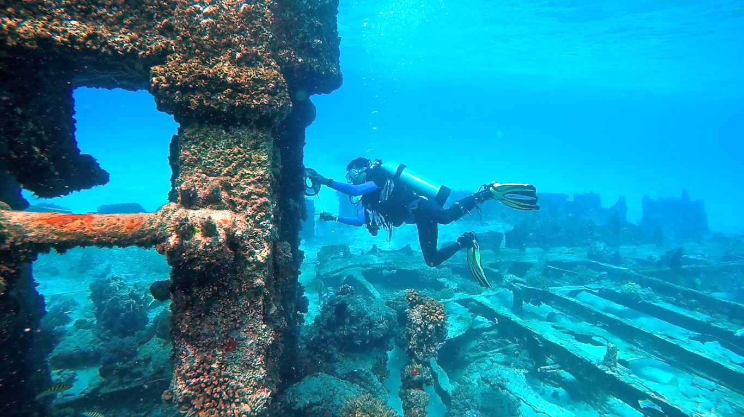
Application Areas of Underwater Image Enhancement
Underwater Archaeology
Enhancing underwater images is essential for documenting and studying underwater archaeological sites and artifacts
Underwater Image Enhancement

Slide 7
Oceanography and Environmental Monitoring
Application Areas of Underwater Image Enhancement
Oceanography is the scientific study of the Earth's oceans and their various components, including the physical, chemical, biological, and geological aspects. Underwater images are used to monitor environmental changes in oceans Includes studying pollution, coral bleaching, and the effects of climate change
Underwater Image Enhancement

Slide 8
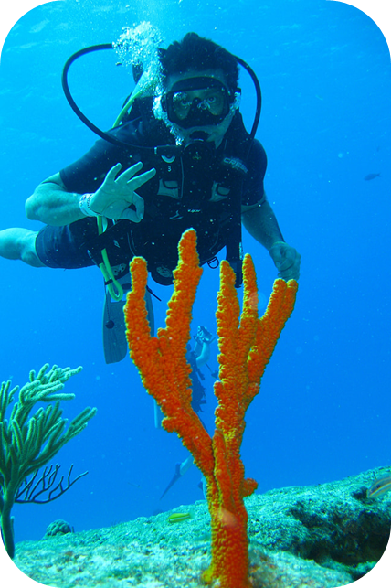
Application Areas of Underwater Image Enhancement
Underwater Exploration
Analyze marine life in previously unexplored regions.
Researchers and explorers use enhanced underwater images to discover and study underwater structures and geological formations
Underwater Image Enhancement

Slide 9
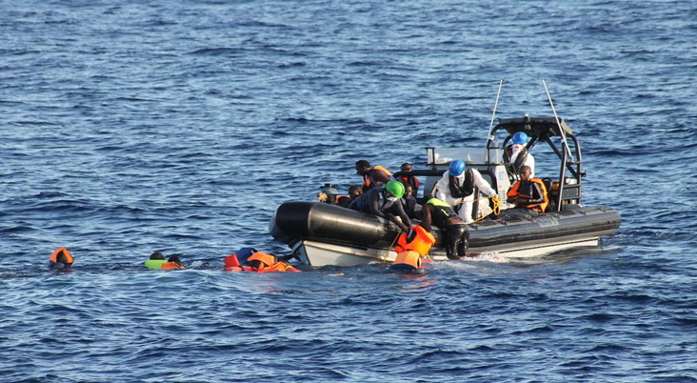
Application Areas of Underwater Image Enhancement
Search and Rescue Operations
Clear underwater images are crucial for locating missing persons, submerged vehicles, and other objects
Underwater Image Enhancement

Slide 10
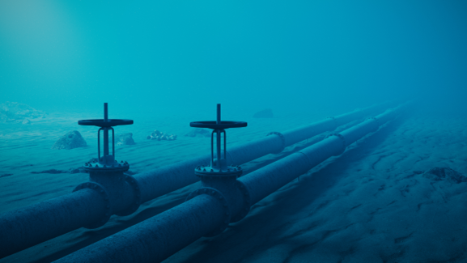
Application Areas of Underwater Image Enhancement
Underwater Infrastructure Inspection:
Many Industries use underwater pipeline to transport oil and gas, and it requires regular inspection. Enhanced images can aid in identifying corrosion, structural damage, and other issues that might impact the safety and functionality of these structures.
Underwater Image Enhancement

Slide 11
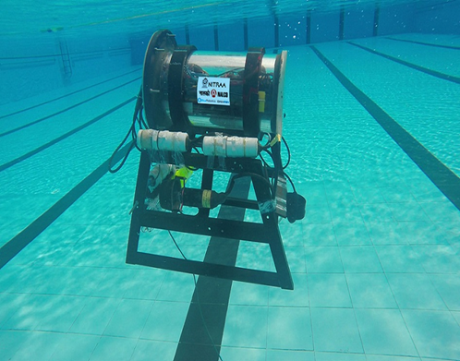
Underwater Robotics and Autonomous Vehicles
Application Areas of Underwater Image Enhancement
Enhanced images improve the performance of underwater robots and autonomous vehicles
Enable effective navigation and task completion in challenging underwater environments
Tiburon 2.0
The second warrior
Underwater Image Enhancement

Slide 12
Research Problems
Research Problems
Research Problems
Underwater Image Enhancement

Slide 13
Dataset Collection Difficulties
Research Problems
One of the most significant challenges is acquiring a dataset of underwater images. Access to underwater environments, especially deep-sea, can be challenging and expensive. Underwater conditions vary significantly based on water type (saltwater, freshwater), depth, and location (ocean, lake, river). Collecting images that cover this wide range of conditions can be logistically complex.
Underwater Image Enhancement

Slide 14
Color Imbalance
Research Problems
Water absorbs the light. This makes colors less vibrant and the image less clear. So, underwater photos often look blue or green. Sometimes, the water absorbs colors differently, causing color distortion in the image. Fixing this is tricky and needs advanced techniques.
Underwater Image Enhancement

Slide 15
Low Light
Research Problems
In deeper underwater, there’s less sunlight. This makes the images dark, with poor contrast and lots of noise, making it hard to see details. To brighten things up, divers often use unique underwater lights. However, handling these lights in different underwater situations can be tricky and require special skills. Due to limited light in the underwater environment, the noise increased in the underwater images.
Underwater Image Enhancement

Slide 16
Diverse Underwater Conditions
Research Problems
Different underwater environments present unique challenges that require specific techniques to handle the situations.
Underwater Image Enhancement

Slide 17
Underwater Equipment Limitations
Research Problems
The equipment required for underwater photography, such as waterproof cameras and submersibles, can be expensive. Maintaining and operating these equipment in harsh underwater environments can pose technical and financial challenges.
Underwater Image Enhancement

Slide 18
Research Objectives
Research Objectives
Research Objectives
Underwater Image Enhancement

Slide 19
My Research Objectives
Research Objectives
to investigate cutting-edge underwater picture-enhancing methods.
To create a model that can efficiently improve and address the issue of color inequities and poor contrast.
Simulated results to demonstrate the effectiveness of our suggested model.
Underwater Image Enhancement

Slide 20
Research Question
Research Questions
Research Questions
Underwater Image Enhancement

Slide 21
Research Question
Research Question
How the visibility can be improved in low-light conditions?
Can deep learning methods be used to enhance underwater images?
Can underwater photographs be improved using CNN techniques?
Underwater Image Enhancement

Slide 22
Literature Review
Literature Review
Literature Review
Underwater Image Enhancement

Slide 23
Literature Review
Literature Review
LR Table:
Paper name | Author | Publisher | Year | Type | Method | Paired/Unpaired
Underwater image enhancement: A comprehensive review, recent trends, challenges and applications | Smitha Raveendran Mukesh D. Patil Gajanan K. Birajdar | Springer | 2021 | Traditional | Polarization-Difference Imaging (PDI) | Paired
Fast Underwater Image Enhancement -GAN with Enhanced Underwater Visual Perception Dataset | Md Jahidul Islam Youya Xia Junaed Sattar | IEEE | 2020 | DL | CNN, GAN | Both Paired and Unpaired
A deep CNN method for underwater image enhancement | Yang Wang, Jing Zhang, Yang Cao, Zengfu Wang | IEEE | 2017 | DL | CNN | Paired
Underwater Image Enhancement

Slide 24
Literature Review
Literature Review
LR Table:
Paper name | Author | Publisher | Year | Type | Method | Paired/Unpaired
Underwater Image Enhancement Benchmark and Beyond | Chongyi Li, Jichang Guo, Yawei Liang, Changqun Xia, Hengzhu Liu, Kun Li | IEEE | 2019 | Traditional | Image Processing | Paired
Underwater Image High Definition Display Using the Multilayer Perceptron and Color Feature-Based SRCNN | Yujie Li; Chunyan Ma; Tingting Zhang; Jianru Li; Zongyuan Ge; Yun Li; Seiichi Serikawa | IEEE | 2019 | ML | Multilayer Perceptron and Color Feature-Based SRCNN | Paired
Underwater Image Enhancement via Minimal Color Loss and Locally Adaptive Contrast Enhancement | Chongyi Li, Xiaojie Guo, Chunle Guo, Xin Liang, Chuan Wang | IEEE | 2022 | Traditional | Minimal Color Loss and Locally Adaptive Contrast Enhancement (MLLE) | Paired
Underwater Image Enhancement

Slide 25
Literature Review
Literature Review
Rest of the Table:
https://docs.google.com/spreadsheets/d/1qIPwl6-TfQV_gfhUg3Nh_B58VSep5DfcFgBm4RzM7No/edit?usp=sharing
Underwater Image Enhancement

Slide 26
Methodology
Methodology
Methodology
Underwater Image Enhancement

Slide 27
Basic Image Processing Techniques
Methodology
Basic image processing techniques are known as fundamental procedures that change digital images to improve their quality, extract valuable information, or get them ready for future analysis. There are numerous methods for processing images, including gamma correction, picture segmentation, image restoration, etc. Gamma correction is used to control the overall brightness of images. It is also used with photos that are found to be either bleached out or too dark.
Underwater Image Enhancement

Slide 28
CNN Models
Methodology
Convolutional neural networks (CNNs) have excelled at several image-improving tasks. The goal of image enhancement is to raise the standard of an image by making it more aesthetically pleasing, easier to understand, or more suitable for a given application. Because CNNs are skilled at learning intricate patterns and characteristics from huge datasets, they can be used for image-enhancing applications.
Underwater Image Enhancement

Slide 29
Proposed Approach
Proposed Approach
Proposed Approach
Underwater Image Enhancement

Slide 30
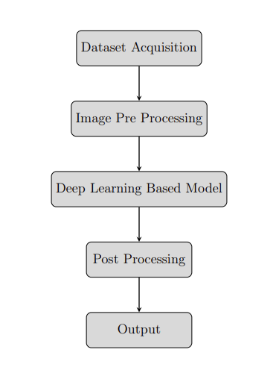
Proposed Approach
Proposed Approach
Underwater Image Enhancement

Slide 31
Image Pre-Processing Results
Image Pre-Processing Results
Image Pre-Processing Results
Underwater Image Enhancement

Slide 32
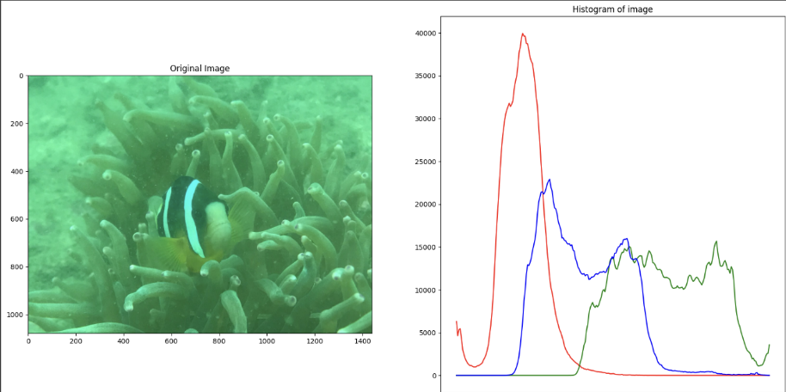
Image Pre-Processing Results
Image Pre-Processing Results
Plotting the histograms of each channel of image.
Underwater Image Enhancement

Slide 33
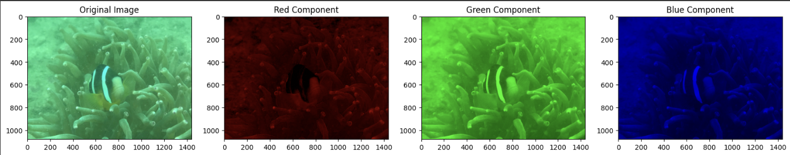
Image Pre-Processing Results
Image Pre-Processing Results
Plotting R, G, and B components of the image.
Underwater Image Enhancement

Slide 34
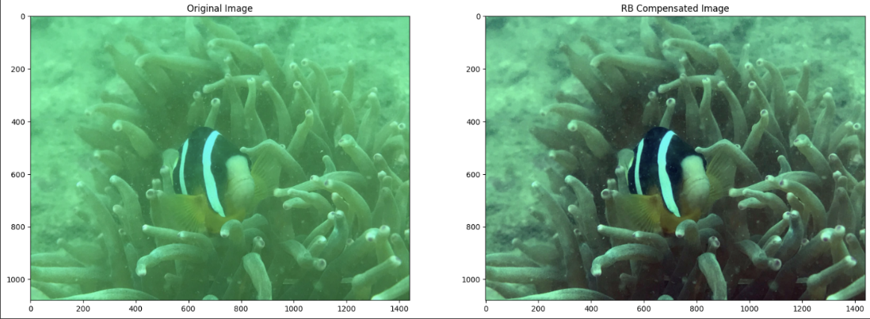
Image Pre-Processing Results
Image Pre-Processing Results
Color Correction (Compensating R and B).
Underwater Image Enhancement

Slide 35
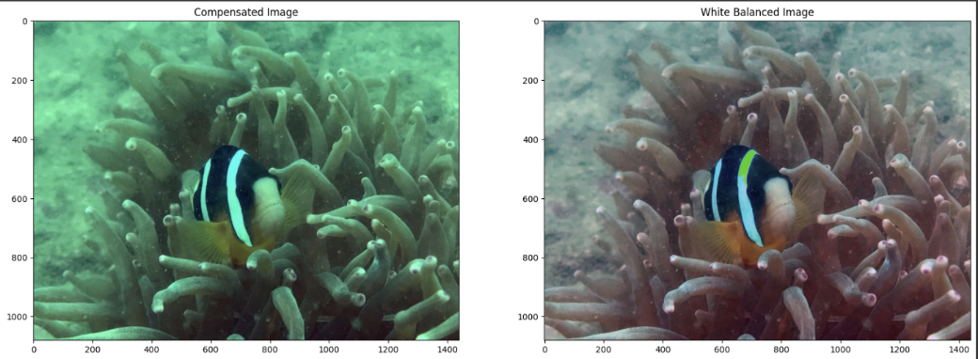
Image Pre-Processing Results
Image Pre-Processing Results
White balancing using the Gray World Algorithm.
Underwater Image Enhancement

Slide 36
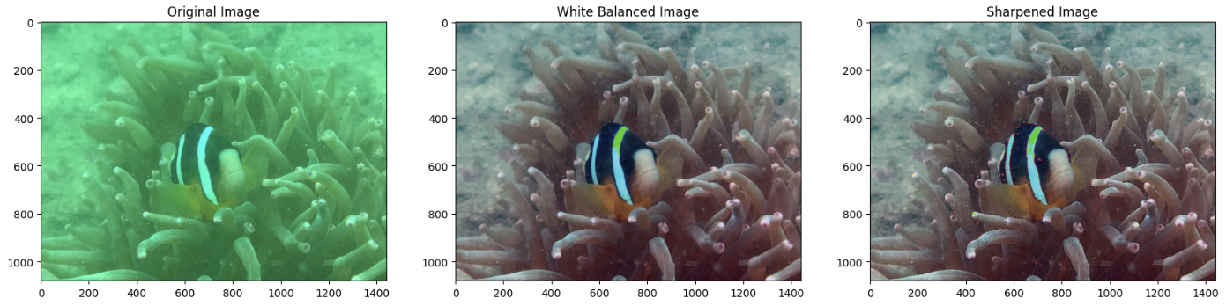
Image Pre-Processing Results
Image Pre-Processing Results
Image Sharpening Of White Balanced Image.
Underwater Image Enhancement

Slide 37
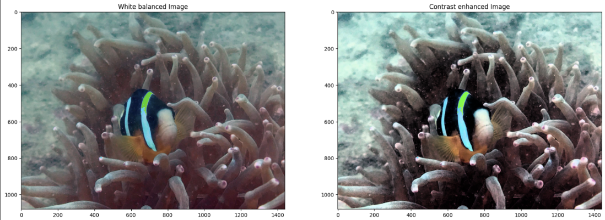
Image Pre-Processing Results
Image Pre-Processing Results
Contrast enhancement of white balanced image by Global Histogram Equalization.
Underwater Image Enhancement

Slide 38
Expected Contributions
Expected Contributions
Expected Contributions
Underwater Image Enhancement

Slide 39
Improved Underwater Imaging
Expected Contributions
The underwater image quality will improve as a result of this research. This is significant for marine biologists, underwater explorers, and businesses like robotics and inspections since it improves their ability to see and comprehend what is occurring below the surface.
Underwater Image Enhancement

Slide 40
User-Friendly Algorithm
Expected Contributions
This research aims to create a user-friendly deep-learning method that will make Underwater image enhancement is easier. Thanks to this breakthrough, users of all backgrounds can easily enhance the quality of their underwater visuals.
Underwater Image Enhancement

Slide 41
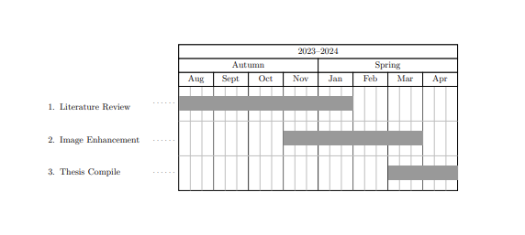
Timeline
Timeline
Underwater Image Enhancement

Slide 42
CONCLUSION
CONCLUSION
Enhancing underwater images is difficult for a variety of reasons. The caliber of underwater photos can now be improved thanks to considerable advancements in recent years and in various ways. There are two varieties of underwater image enhancement. The other is based on deep learning techniques, whereas the first is based on traditional image-processing methods. Deep learning-based algorithms are a potent new tool for underwater image enhancement. Traditional image-processing techniques include color correction, contrast enhancement, and noise reduction. For underwater image improvement, some difficulties must be overcome. The fact that current techniques were created for certain underwater settings is one of the difficulties. As a result, not all underwater photos can be captured effectively using a single technique. Another difficulty is that deep learning-based approaches need a lot of training data, which is very hard to gather.
Underwater Image Enhancement

Slide 43
References I
References
Saeed Anwar, Chongyi Li, and Fatih Porikli. Deep underwater image enhancement. arXiv preprint arXiv:1807.03528, 2018.
Linfeng Bai, Weidong Zhang, Xipeng Pan, and Chenping Zhao. Underwater image enhancement based on global and local equalization of histogram and dual-image multi-scale fusion. IEEE Access, 8:128973–128990, 2020.
Long Chen, Zheheng Jiang, Lei Tong, Zhihua Liu, Aite Zhao, Qianni Zhang, Junyu Dong, and Huiyu Zhou. Perceptual underwater image enhancement with deep learning and physical priors. IEEE Transactions on Circuits and Systems for Video Technology, 31(8):3078–3092, 2020.
Xuelei Chen, Pin Zhang, Lingwei Quan, Chao Yi, and Cunyue Lu. Underwater image enhancement based on deep learning and image formation model. arXiv preprint arXiv:2101.00991, 2021.
Xueyang Fu and Xiangyong Cao. Underwater image enhancement with global–local networks and compressed- histogram equalization. Signal Processing: Image Communication, 86:115892, 2020.
Yecai Guo, Hanyu Li, and Peixian Zhuang. Underwater image enhancement using a multiscale dense generative adversarial network. IEEE Journal of Oceanic Engineering, 45(3):862–870, 2019.
Praful Hambarde, Subrahmanyam Murala, and Abhinav Dhall. Uw-gan: Single-image depth estimation and image enhancement for underwater images. IEEE Transactions on Instrumentation and Measurement, 70:1–12, 2021.
Guojia Hou, Xin Zhao, Zhenkuan Pan, Huan Yang, Lu Tan, and Jingming Li. Benchmarking underwater image enhancement and restoration, and beyond. IEEE Access, 8:122078–122091, 2020.
Underwater Image Enhancement

Slide 44
References II
References
Md Jahidul Islam, Youya Xia, and Junaed Sattar. Fast underwater image enhancement for improved visual perception.
IEEE Robotics and Automation Letters, 5(2):3227–3234, 2020.
Qiuping Jiang, Yuese Gu, Chongyi Li, Runmin Cong, and Feng Shao. Underwater image enhancement quality eval- uation: Benchmark dataset and objective metric. IEEE Transactions on Circuits and Systems for Video Technology, 32(9):5959–5974, 2022.
Zhiying Jiang, Zhuoxiao Li, Shuzhou Yang, Xin Fan, and Risheng Liu. Target oriented perceptual adversarial fusion network for underwater image enhancement. IEEE Transactions on Circuits and Systems for Video Technology, 32(10):6584–6598, 2022.
Chongyi Li, Saeed Anwar, Junhui Hou, Runmin Cong, Chunle Guo, and Wenqi Ren. Underwater image enhancement via medium transmission-guided multi-color space embedding. IEEE Transactions on Image Processing, 30:4985–5000, 2021.
Chongyi Li, Chunle Guo, Wenqi Ren, Runmin Cong, Junhui Hou, Sam Kwong, and Dacheng Tao. An underwater image enhancement benchmark dataset and beyond. IEEE Transactions on Image Processing, 29:4376–4389, 2019.
Peng Liu, Guoyu Wang, Hao Qi, Chufeng Zhang, Haiyong Zheng, and Zhibin Yu. Underwater image enhancement with a deep residual framework. IEEE Access, 7:94614–94629, 2019.
Risheng Liu, Zhiying Jiang, Shuzhou Yang, and Xin Fan. Twin adversarial contrastive learning for underwater image enhancement and beyond. IEEE Transactions on Image Processing, 31:4922–4936, 2022.
32/35
Underwater Image Enhancement

Slide 45
References III
References
Shima Ramesh Maniyath, K Vijayakumar, Laxman Singh, Sudhir Kumar Sharma, and Tunde Olabiyisi. Learning-based approach to underwater image dehazing using cyclegan. Arabian Journal of Geosciences, 14(18):1908, 2021.
G Ramkumar, M Ayyadurai, C Senthilkumar, et al. An effectual underwater image enhancement using deep learning algorithm. In 2021 5th International Conference on Intelligent Computing and Control Systems (ICICCS), pages 1507–1511. IEEE, 2021.
Smitha Raveendran, Mukesh D Patil, and Gajanan K Birajdar. Underwater image enhancement: a comprehensive review, recent trends, challenges and applications. Artificial Intelligence Review, 54:5413–5467, 2021.
Yan Wang, Wei Song, Giancarlo Fortino, Li-Zhe Qi, Wenqiang Zhang, and Antonio Liotta. An experimental-based review of image enhancement and image restoration methods for underwater imaging. IEEE access, 7:140233–140251, 2019.
Yang Wang, Jing Zhang, Yang Cao, and Zengfu Wang. A deep cnn method for underwater image enhancement. In
2017 IEEE international conference on image processing (ICIP), pages 1382–1386. IEEE, 2017.
Hao-Hsiang Yang, Kuan-Chih Huang, and Wei-Ting Chen. Laffnet: A lightweight adaptive feature fusion network for underwater image enhancement. In 2021 IEEE International Conference on Robotics and Automation (ICRA), pages 685–692. IEEE, 2021.
Haifeng Yu, Xinbin Li, Qian Lou, Chengbo Lei, and Zhixin Liu. Underwater image enhancement based on dcp and depth transmission map. Multimedia Tools and Applications, 79:20373–20390, 2020.
Underwater Image Enhancement

Slide 46
References IV
References
Weidong Zhang, Peixian Zhuang, Hai-Han Sun, Guohou Li, Sam Kwong, and Chongyi Li. Underwater image enhance- ment via minimal color loss and locally adaptive contrast enhancement. IEEE Transactions on Image Processing, 31:3997–4010, 2022.
Jingchun Zhou, Boshen Li, Dehuan Zhang, Jieyu Yuan, Weishi Zhang, Zhanchuan Cai, and Jinyu Shi. Ugif-net: An efficient fully guided information flow network for underwater image enhancement. IEEE Transactions on Geoscience and Remote Sensing, 2023.
Jingchun Zhou, Lei Pang, Dehuan Zhang, and Weishi Zhang. Underwater image enhancement method via multi- interval subhistogram perspective equalization. IEEE Journal of Oceanic Engineering, 2023.
Jingchun Zhou, Dehuan Zhang, and Weishi Zhang. Underwater image enhancement method via multi-feature prior fusion. Applied Intelligence, 52(14):16435–16457, 2022.
Peixian Zhuang and Xinghao Ding. Underwater image enhancement using an edge-preserving filtering retinex algorithm.
Multimedia Tools and Applications, 79:17257–17277, 2020.
Peixian Zhuang, Jiamin Wu, Fatih Porikli, and Chongyi Li. Underwater image enhancement with hyper-laplacian reflectance priors. IEEE Transactions on Image Processing, 31:5442–5455, 2022.
Underwater Image Enhancement

Slide 47
Thank You!
Underwater Image Enhancement

